Slide 1
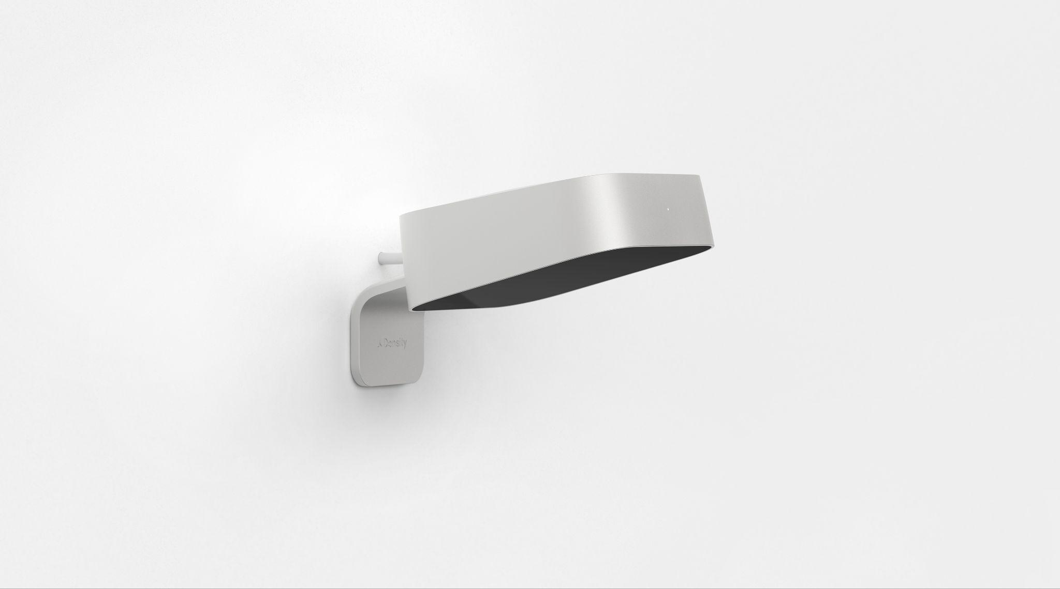
Entry Long Range to Entry Replacement Guide
Entry Long Range
Entry
© 2025 DENSITY

Slide 2
Contents
01 — Introduction
02 — Hardware and Networking
03 — Sensor Temperature
04 — Wall Mount Replacement
05 — Suspended Mount Replacement

Slide 3
Introduction
01
This guide provides the steps to successfully replace an Entry Long Range sensor with an Entry sensor. The Entry Sensor will need to be recommissioned by a remote Density employee once the sensor is online. Please email your Density contact when the replacement is complete so we can make the appropriate platform changes and commission the sensor.
Note: Unless otherwise specified, the same mounting option will be used.
Please contact support@density.io with any questions.

Slide 4
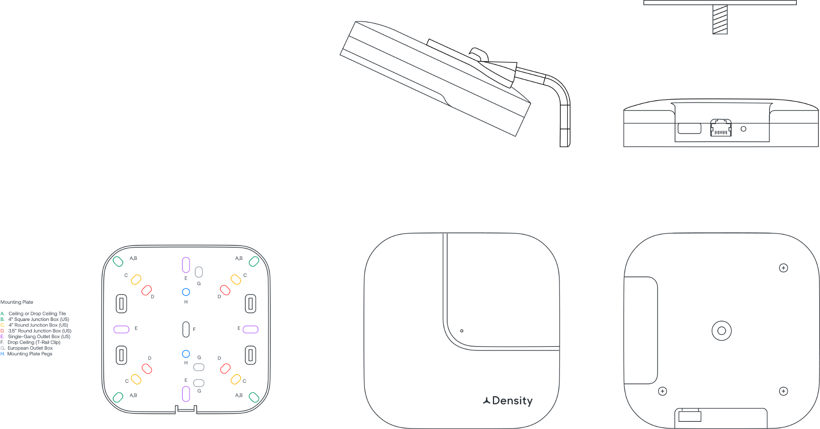
Hardware & Networking
02
Entry Long Range Dimensions
White polycarbonate enclosure
Powder coated aluminum base
Integrated 1/4”-20 mounting threads
Thread depth: 0.2in (0.5cm)
Mount plate
Interface
1x 10/100/1000 BaseT RJ45 interface
WiFi/Bluetooth dongle
Reset button
Mounting Plate
Mounting Bracket
WiFi/Bluetooth Dongle
Reset Button
1.32 in 3.4 cm
Ethernet/PoE
Hidden Indicator LED
¼ in - 20 Thread
4.88 in
12.4 cm

Slide 5
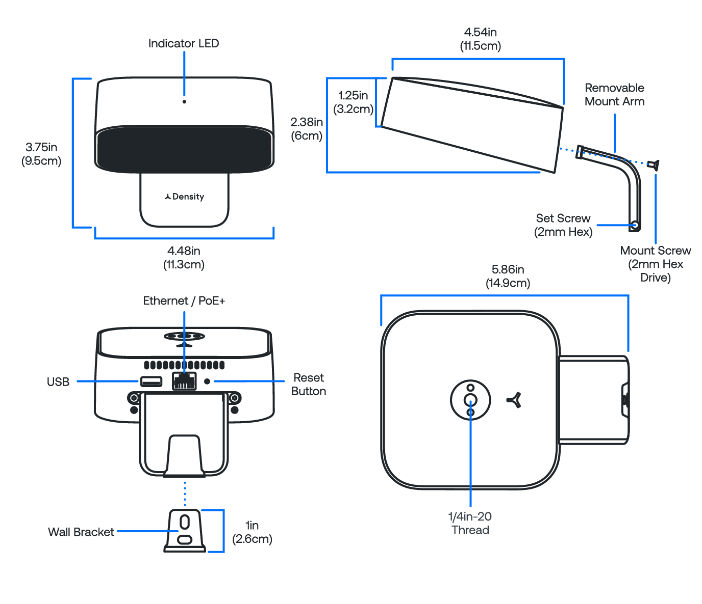
Entry Dimensions
Enclosure Material: Anodized Aluminum
Window Material: IR PMMA Plastic
Removable Mount Arm
1/4in-20 threads for ceiling mounting

Slide 6
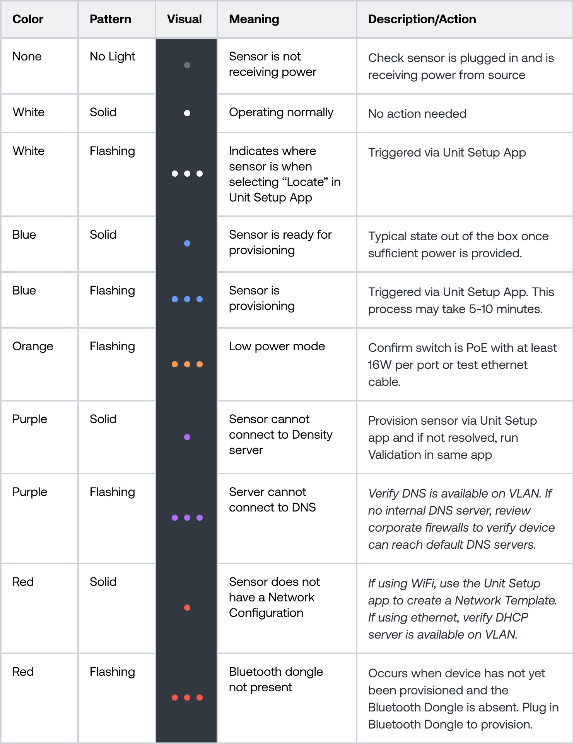
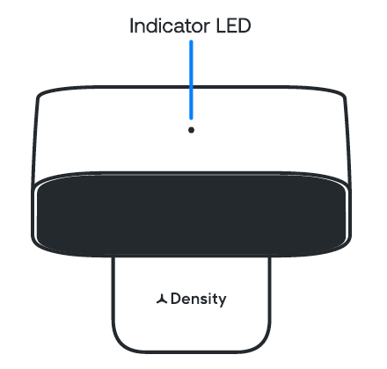
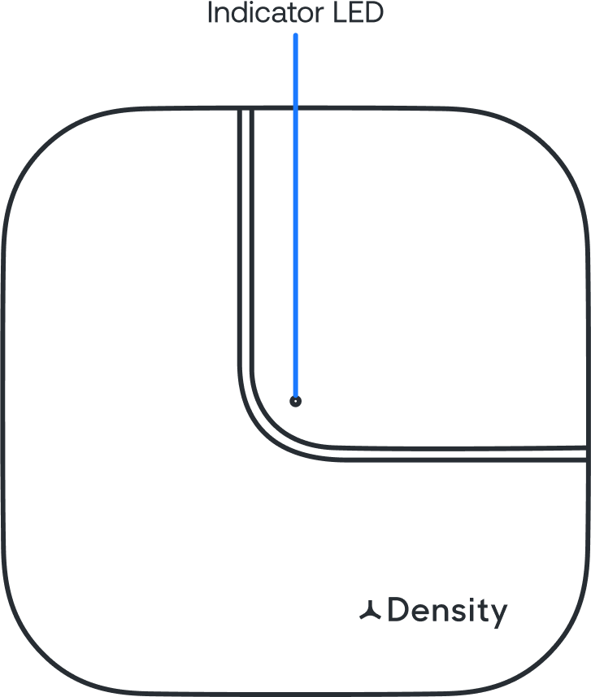
Sensor LED status indicator
The sensor has a status indicator LED located on the sensor. The color chart to the right explains the meaning of each color, defines any issues, and lists what actions to take if necessary.
If the recommended action does not resolve the LED light error status, factory reset the sensor. To reset, press and hold the reset button on the back of the sensor until the LED light starts flashing white. If the issue persists, please contact support@density.io.

Slide 7
Networking basics
If you have a corporate firewall
Setup App
Density devices require internet connectivity to pass data to the web application.
Recommended Configuration: Wired ethernet connectivity configured via DHCP with internal NTP and internal DNS servers. IPv4 is required.
Networks that are not supported:
Captive portal
Proxy
WPA2 Enterprise
Hidden Networks *
5GHz WiFi networks
* Hidden networks can be used if temporarily made transparent while we configure the devices.
You will need to safelist the device MAC addresses (the MAC addresses can be found on the outside of the packaging box for the device). You may also have to safelist the following addresses to ensure the device is able to communicate outside of your corporate network:
*.density.io (port 443*)
*.amazonaws.com
*.gstatic.com
An Internal DNS server is strongly recommended. If using Public DNS, please ensure the following are whitelisted (optional):
8.8.8.8
8.8.4.4
An internal NTP server is strongly recommended. For NTP and time synchronization, please ensure the following are whitelisted:
*connman.net
*.ntp.org (port 123)
Note: A list of all subdomains Density sensors communicate to can be provided upon request.
See our Technical Specifications for more details.
Used to configure and troubleshoot units. iOS and Android application available - Go to mobile.density.io to download.

Slide 8
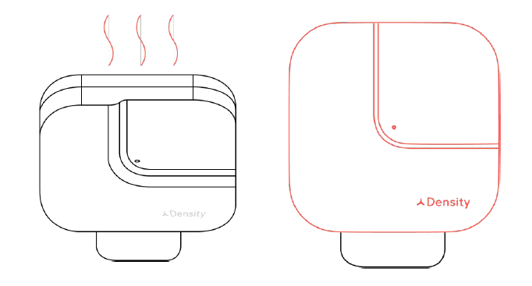
Sensor Temperature
03
Temperature
The aluminum enclosure of the sensor is expected to be hot during operation. Density sensors comply with certification temperature requirements and do not pose any risk of burning the skin or causing fires.
If the sensor has been powered on for an extended period of time, we recommend removing the power cable and allow the sensor to cool for at least 5 minutes before handling.

Slide 9
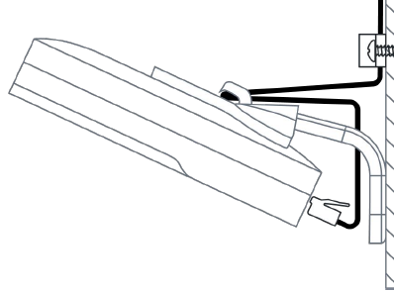
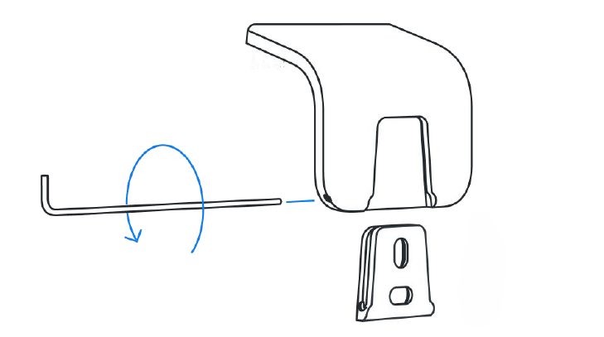
Wall Mount Replacement
04
Step 1: Remove the network cable from Entry Long Range Sensor and allow the device to cool if needed.
Step 2: Remove the 2mm anchor screw from the bracket and leave anchor in place as the new device will use the same anchor and screw that was just removed.

Slide 10
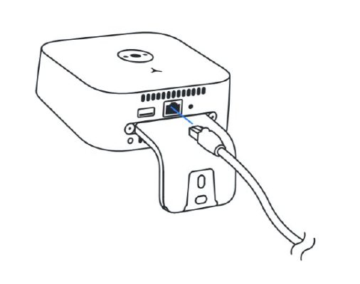
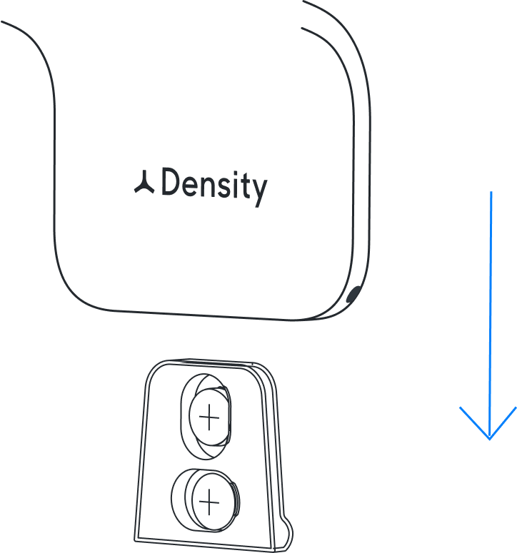
Step 3: Power Up The Entry Sensor
Plug in the ethernet cable. The sensor will automatically power up, and the LED indicator on the front of the sensor will turn white. See this article for troubleshooting information if you see any other colors on the LED indicator.
Step 4: Wall Mount
Slide the Entry Sensor downward onto the installed wall bracket.

Slide 11
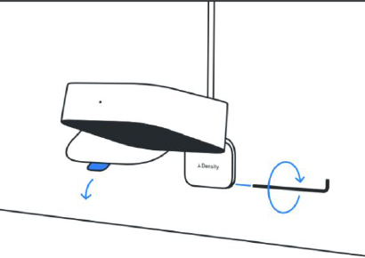
Step 5: Lock Sensor and Peel Film
Lock the sensor to the wall bracket with the
provided hex key by twisting the set screw all the
way in.
Remove the protective film on the black
window.
Ensure the black sensor window remains free of dust and smudges during operation. Wipe with a microﬁber cloth to remove any accidental smudges.

Slide 12
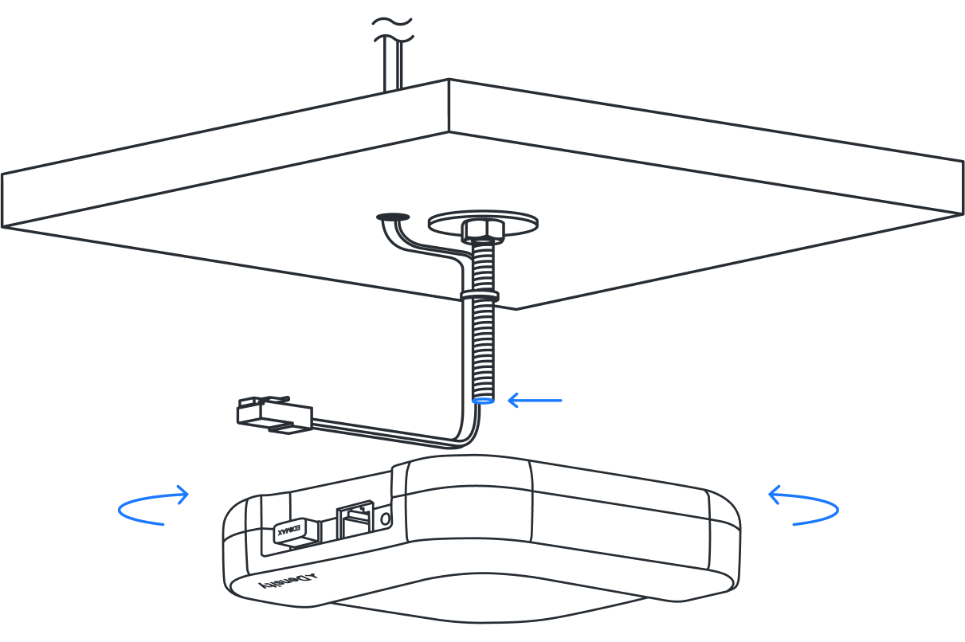
Suspended Mount Replacement
05
Step 1: Remove the network cable and allow the device to cool if needed.
Step 2: Unscrew the Entry Long Range sensor from threaded rod.

Slide 13
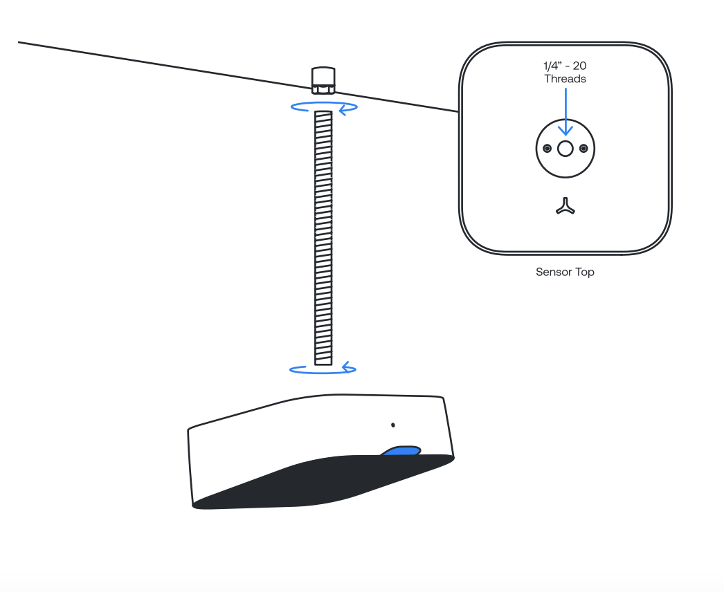
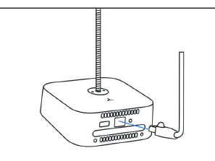
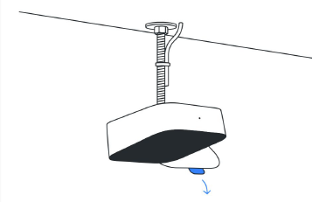
Step 3: Attach the Entry Sensor
Attach the Entry Sensor to the threaded rod by inserting the threaded rod into the 1/4in-20
threads on the top of the sensor and twisting the sensor onto the rod until tight.
Screw the unit on all the way until it stops, then back it off to the prescribed location using the
ethernet jack as the location guide.
Step 4 : Plug in Cable and Peel Film
Plug in the ethernet cable. The sensor will
automatically power up, and the LED indicator on
the front of the sensor will turn white.
Remove the protective ﬁlm on the black window.
Ensure the black sensor window remains free of dust and smudges during operation. Wipe with a microﬁber cloth to remove any accidental smudges.

