Slide 1
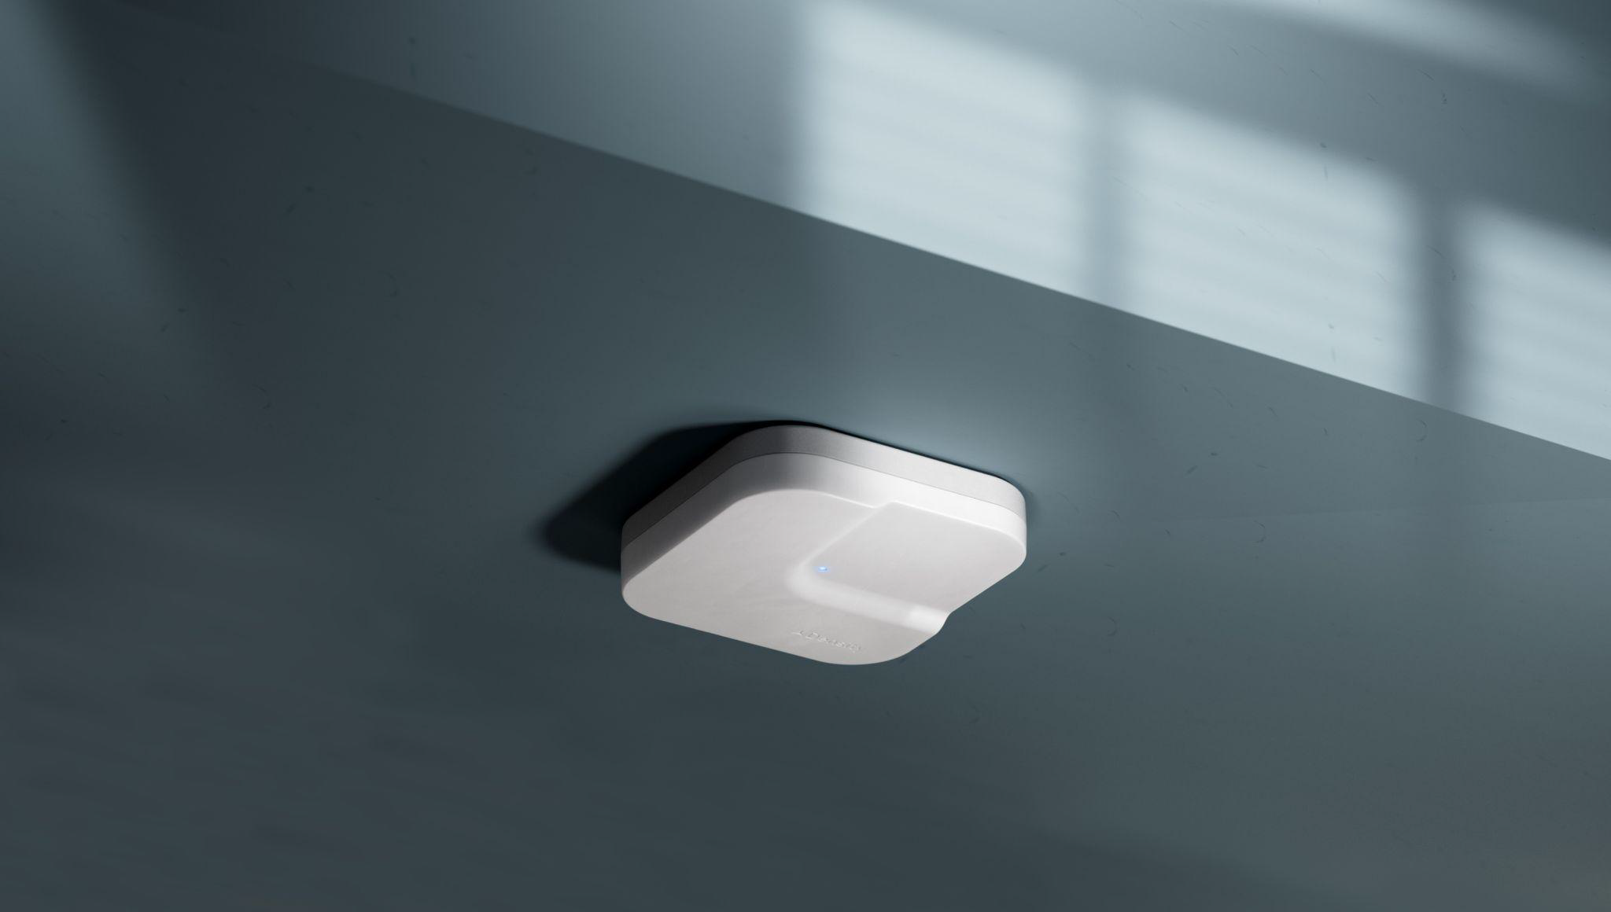
Open Area Long Range Sensor Replacement Guide
© 2025 DENSITY

Slide 2
Contents
01 — Introduction
02 — In the Box
03 — Hardware & Networking
04 — Suspended Mounting
05 — Mount Plate Installation

Slide 3
Introduction
01
This guide provides the steps to successfully replace an Open Area Long Range sensor.
As long as the sensor is replaced and oriented the same as the original sensor, it will perform as intended. If a recommissioning of the sensor is required, it will need to be commissioned with an onsite representative and a remote Density employee. Please email your Density contact when the replacement is complete so we can make the appropriate platform changes.
Note: Unless otherwise specified, the same mounting option will be used
Please contact support@density.io with any questions.

Slide 4
In the Box
02
Product
Ceiling mount kit
Density Open Area Long Range Sensor
QR code for Quick Start Guide
Legal information booklet
Mount plate

Slide 5
Hardware & Networking
03
Sensors
Indicators
Single-chip 60-64GHz mmWave sensor
Multi-color status LED
Environmental specifications
Unit weight
Temperature: 32°- 95°F (0°- 35°C)
Relative humidity: 20% to 80%
Non-condensing
Rated for indoor installation only
Note: Open Area sensors can reach temperatures up to 135ºF (57ºC) after going online. Please keep proper ventilation in mind.
If you need to handle the sensor, unplug it and wait a few minutes for it to cool down, or wear gloves so it is more comfortable to handle the device.
0.78lbs (0.35kg)

Slide 6
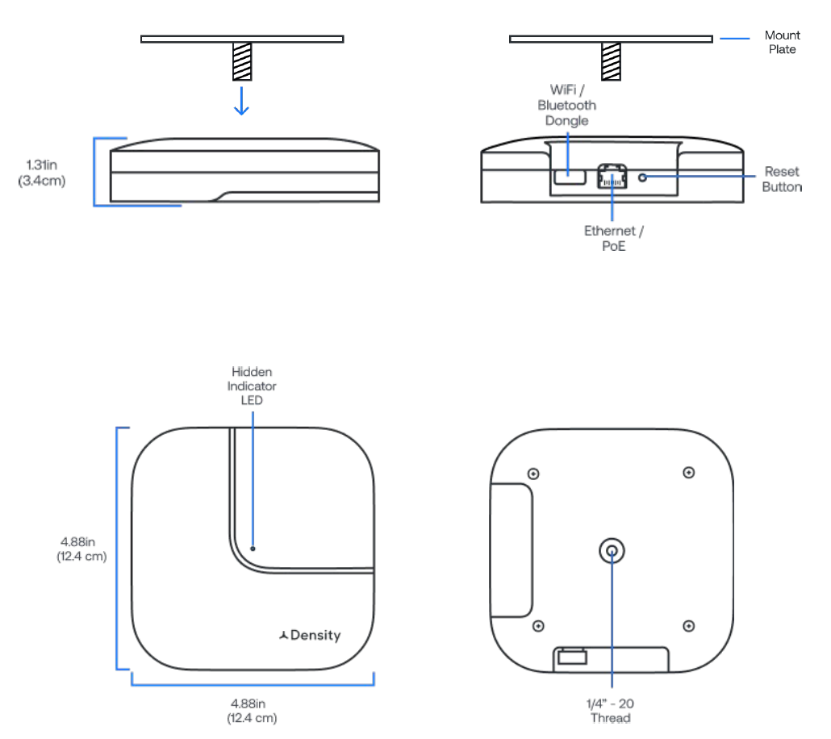
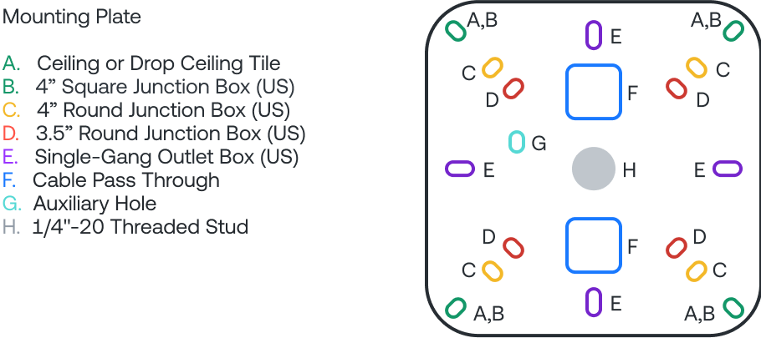
Dimensions & features
White polycarbonate enclosure
Painted aluminum base
Integrated 1/4”-20 mounting threads
Mount plate
Thread depth: 0.2in (0.5cm)
Interface
1x 10/100/1000 BaseT RJ45 interface
WiFi/Bluetooth dongle
Reset button

Slide 7
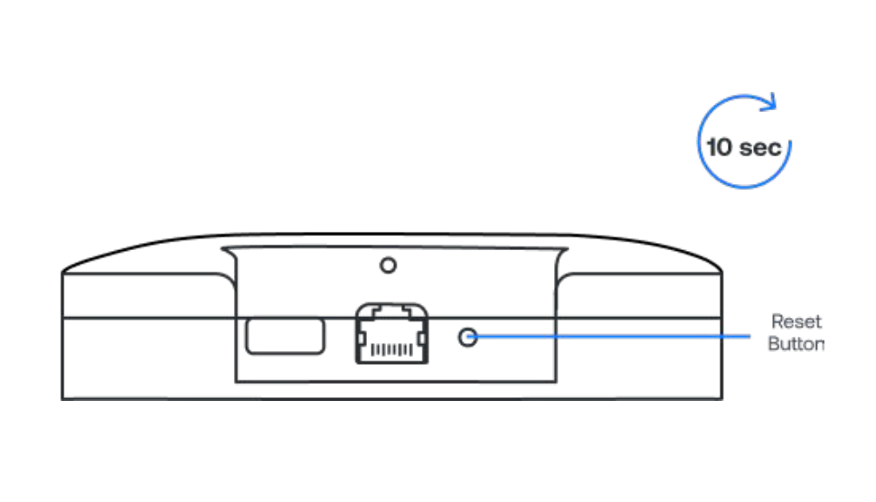
Resetting the sensor
To reset the sensor to default factory settings, press and hold the reset button until the LED
stops blinking (approximately 10 seconds). The sensor must be plugged in and connected to power in order to reset.

Slide 8
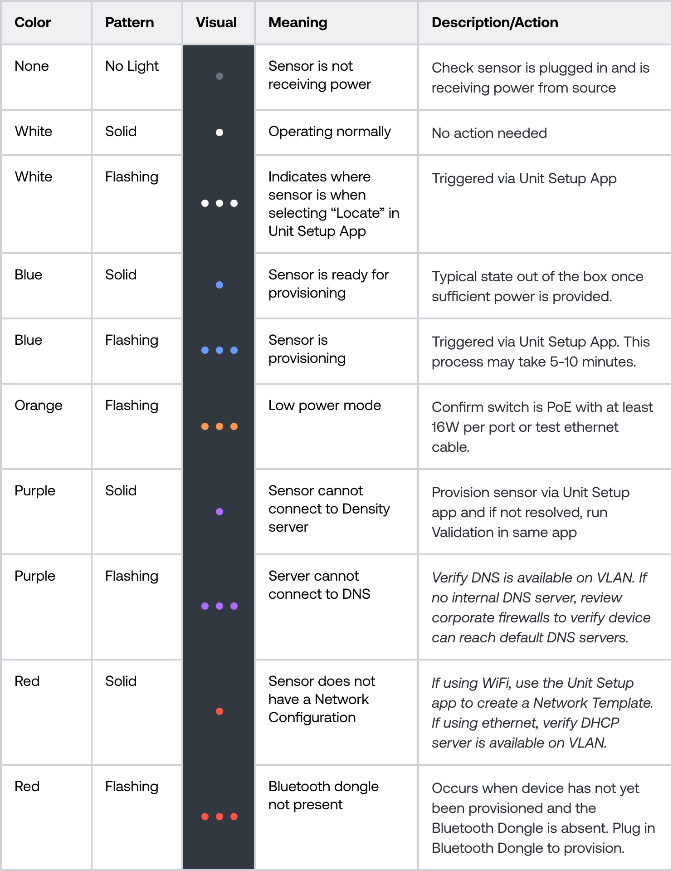
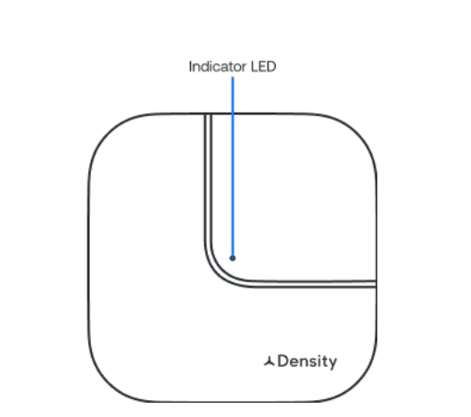
Sensor LED status indicator
The sensor has a status indicator LED located on the front of the sensor. The color chart below
explains the meaning of each color, defines any issues, and lists what actions to take if necessary.
If the recommended action does not resolve the LED light error status, factory reset the sensor. To reset, press and hold the reset button on the side of the sensor until the LED light starts flashing white. If the issue persists, please reach out to support@density.io

Slide 9
Networking basics
If you have a corporate firewall
Setup App
Density devices require internet connectivity to pass data to the web application.
Recommended Configuration: Wired ethernet connectivity configured via DHCP with internal NTP and internal DNS servers. IPv4 is required.
Networks that are not supported:
Captive portal
Proxy
WPA2 Enterprise
Hidden Networks *
5GHz WiFi networks
* Hidden networks can be used if temporarily made transparent while we configure the devices.
You will need to safelist the device MAC addresses (the MAC addresses can be found on the outside of the packaging box for the device). You may also have to safelist the following addresses to ensure the device is able to communicate outside of your corporate network:
*.density.io (port 443*)
*.amazonaws.com
*.gstatic.com
An Internal DNS server is strongly recommended. If using Public DNS, please ensure the following are whitelisted (optional):
8.8.8.8
8.8.4.4
An internal NTP server is strongly recommended. For NTP and time synchronization, please ensure the following are whitelisted:
*connman.net
*.ntp.org (port 123)
Note: A list of all subdomains Density sensors communicate to can be provided upon request.
See our Technical Specifications for more details.
Used to configure and troubleshoot units. iOS and Android application available - Go to mobile.density.io to download.

Slide 10
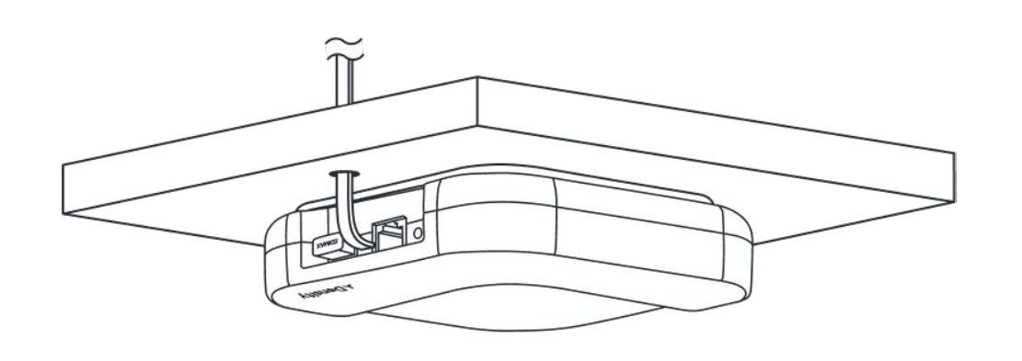
Mount Plate Installation
04

Slide 11
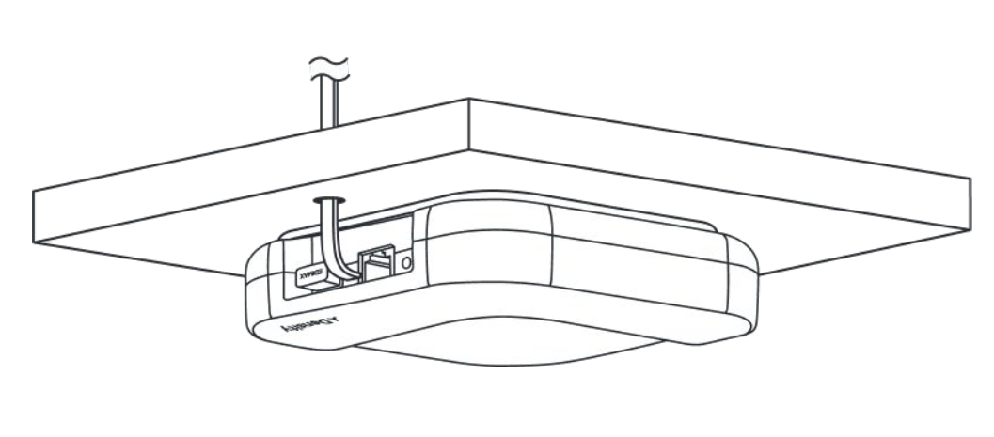
Step 1: Unplug the ethernet cable
Unplug the ethernet cable from the Open Area sensor.
Density sensors comply with certification temperature requirements, and do not pose any risk of burning the skin or causing fires.
If the sensor has been powered on for an extended period of time, we recommend removing the power cable and allow the sensor to cool for at least 5 minutes before handling.

Slide 12
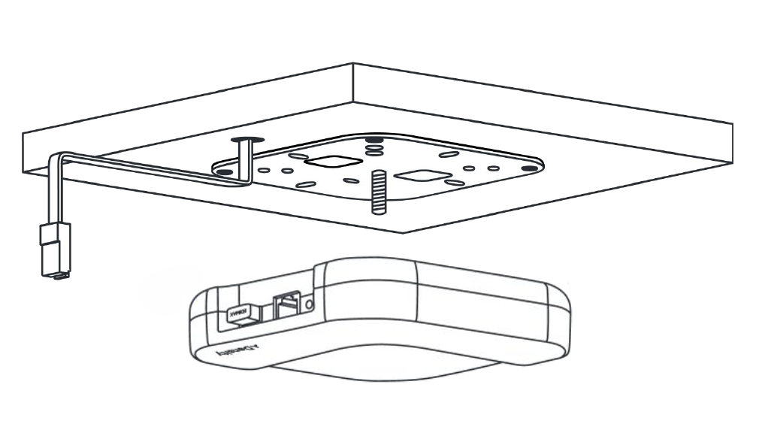
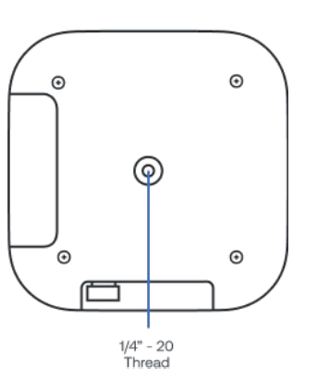
Step 2: Remove defective Open Area sensor
Remove the Open Area sensor by unthreading the sensor from the bracket. Rotate the sensor clockwise to remove.

Slide 13
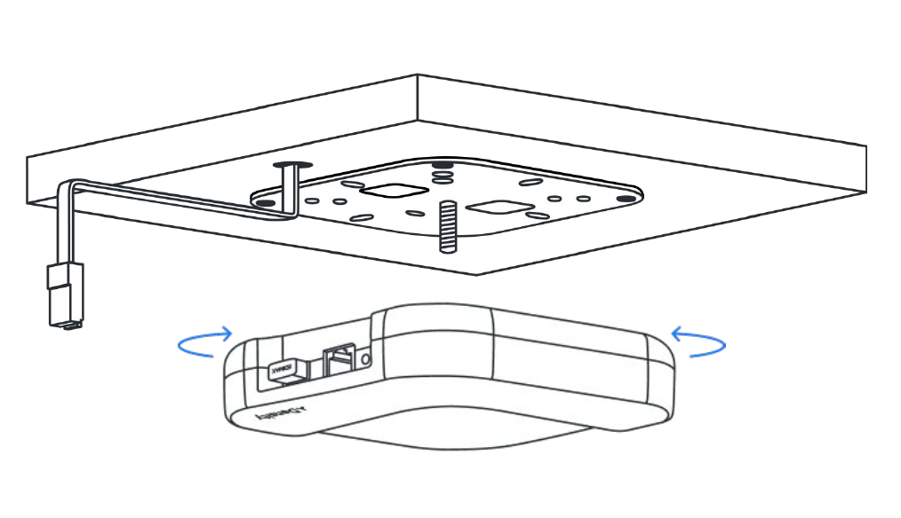
Step 3: Attach replacement Open Area sensor
Attach the Open Area sensor by threading onto the bracket.
Screw the unit on all the way until it stops (do not overtighten), then if needed, loosen the sensor until it is in the correct orientation as the previous sensor.

Slide 14
Step 4: Plug in cable
Plug the ethernet cable into the Open Area sensor.
Ensure the Open Area unit is level and parallel to the floor. The sensor will cycle through LED light colors and should turn solid white. Once the sensor has a solid white LED the replacement is complete.

Slide 15
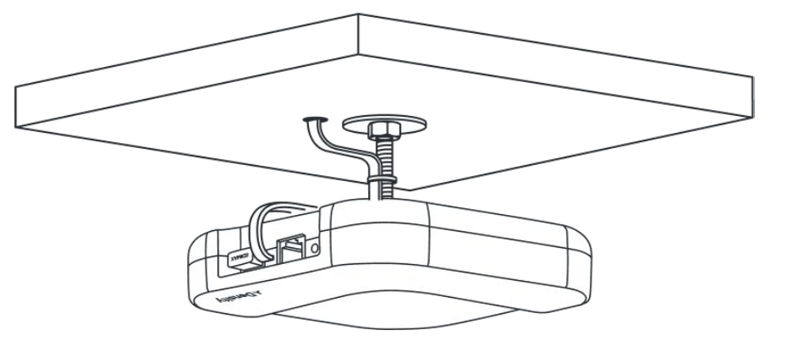
Suspended Mounting
05

Slide 16
Step 1: Unplug the ethernet cable
Unplug the ethernet cable from the Open Area sensor.
Density sensors comply with certification temperature requirements, and do not pose any risk of burning the skin or causing fires.
If the sensor has been powered on for an extended period of time, we recommend removing the power cable and allow the sensor to cool for at least 5 minutes before handling.

Slide 17
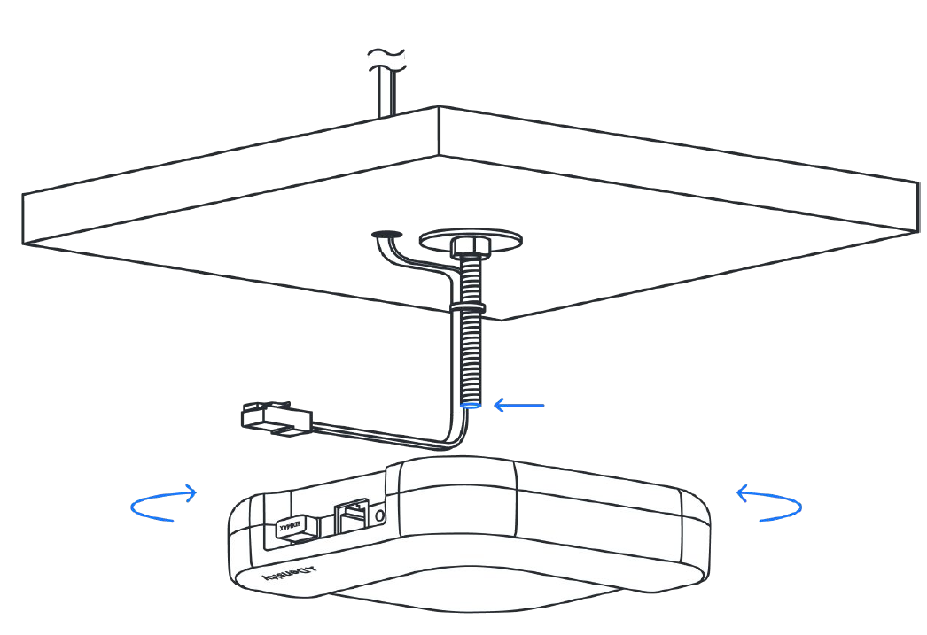
Step 2: Remove defective Open Area sensor
Remove the Open Area sensor by unthreading the sensor from the bracket. Rotate the sensor clockwise to remove.

Slide 18
Step 3: Attach Open Area sensor
Attach the Open Area sensor to the threaded rod by inserting the threaded rod into the 1/4in-20
threads on the top of the Open Area Screw the unit on all the way until it stops (do not overtighten), then if needed, loosen the sensor until it is in the correct orientation as the previous sensor.

Slide 19
Step 4: Plug in cable
Plug the ethernet cable into the Open Area sensor.
Ensure the Open Area unit is level and parallel to the floor. The sensor will cycle through LED light colors and should turn solid white. Once thesensor has a solid white LED the replacement is complete.

