Slide 1
Atlas Floor Plan Uploads

Slide 2
New Floor/Floorplan Swap Requirements
Paste a copy into this document and mark your spaces and doorways following the example on the next slide
Please use the existing space names and doorway names in your Dashboard so we can match your historical data. If you’d like to change the names, you will be able to easily adjust them in Atlas afterward.
Provide a clean copy of the floorplan using these requirements:
Accepted file types: Image (PNG, JPEG, PDF) or CAD (DWG or DXF)
Maximum file size: 10 mb for image files
Maximum width: 10,000 pixels/133 inches

Slide 3
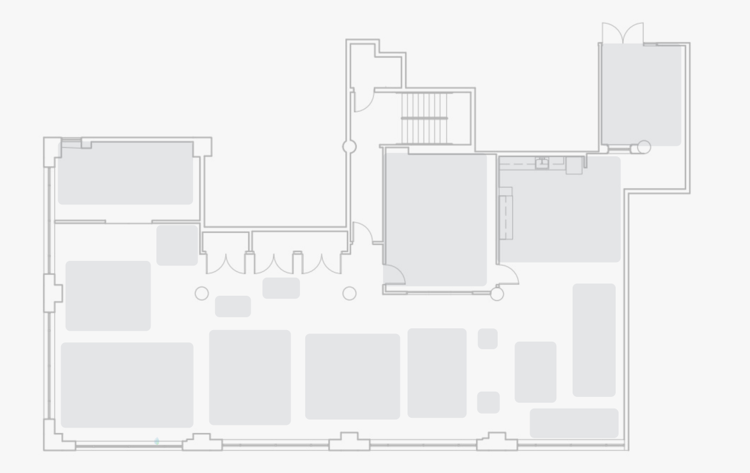
Outline of Setup (Example)
Doorway Name:
Space Name:
Space Name:
Doorway Name:
Doorway Name:

